Slide 1

PVR-INOX Merger: A Strategic Analysis of India’s Largest Multiplex Merger
This presentation analyzes the strategic rationale, synergy potential, and financial implications of the landmark PVR-INOX merger in India’s film exhibition industry.

Slide 2
Executive Summary
1
The merger was completed on January 12, 2023.
2
The combined entity, PVR-INOX, is now India’s largest film exhibition company.
3
The combined entity holds approximately 45-50% of the market share.
4
The merger was valued at INR 18,134 Crore.
5
The swap ratio was 3 shares of PVR for 10 shares of INOX.

Slide 3

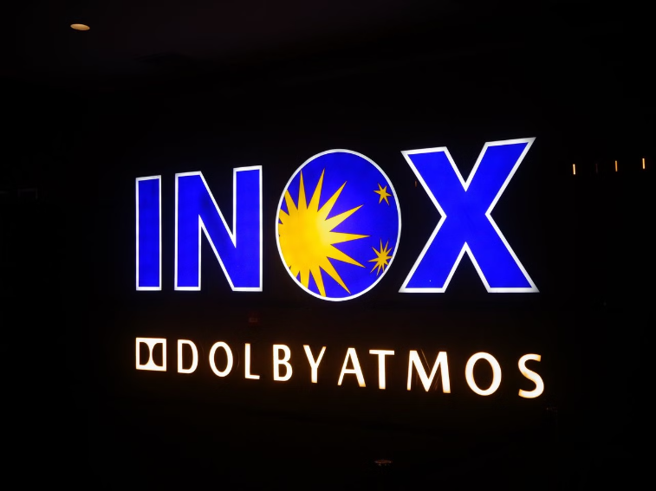
Deal Overview
PVR
INOX
Founded in 1997, PVR is a leading multiplex chain with a strong presence across India and Sri Lanka.
Established in 2002, INOX is a significant multiplex chain operating in 73 cities across India.

Slide 4




Strategic Rationale
Market Expansion
Create a dominant platform, capturing a significant share of the Indian multiplex market.
Cost Efficiency
Leverage economies of scale through combined procurement, operational integration, and technology.
Technology & Innovation
Combine best practices in cinema technology, offering premium cinematic experiences.

Slide 5
Synergy Analysis
1
Reduced procurement costs and centralized operations.
2
Improved food & beverage offerings, cross-selling, and advertising revenues.
3
Optimized screen expansion and technology investments.

Slide 6
Pro Forma Financial Statements
Metric | FY23 (Combined) | FY24 (Projected)
Revenue
₹5,300 Crore
₹6,200 Crore
EBITDA
₹1,800 Crore
₹2,000 Crore
Screens
1,508
1,730+
Seats
335,000
365,000+
Occupancy
30%
33%
Footfall
153 Mn
165+ Mn

Slide 7
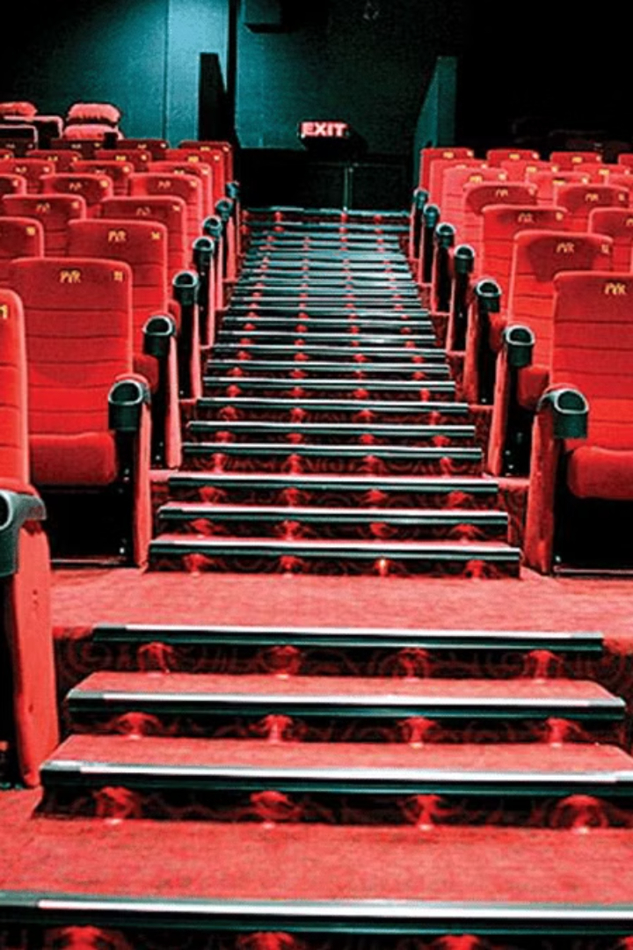
Valuation Impact
17.4B
Valuation
Post-merger valuation (INR)
The merger is expected to create significant value for shareholders, driven by enhanced market share, cost synergies, and revenue growth.

Slide 8
Risk Analysis
Regulatory Risks
Cultural Integration
Potential antitrust scrutiny due to the combined entity's significant market share.
Challenges in merging different management styles and corporate cultures.
Synergy Realization
Risk of overestimating cost and revenue synergies, leading to potential shortfalls.

Slide 9
Deal Recommendations
Actionable Insights:
Emphasize premium cinema formats to counter OTT competition
Invest in unified loyalty programs and digital engagement
Implement phased integration to minimize disruptions
Sources & References
Sources:
Publicly available company filings, annual reports
Bloomberg, FactSet, and other financial data sources
Relevant industry reports (general reference without mentioning internal files)

Slide 10
THANKYOU.

